Slide 1
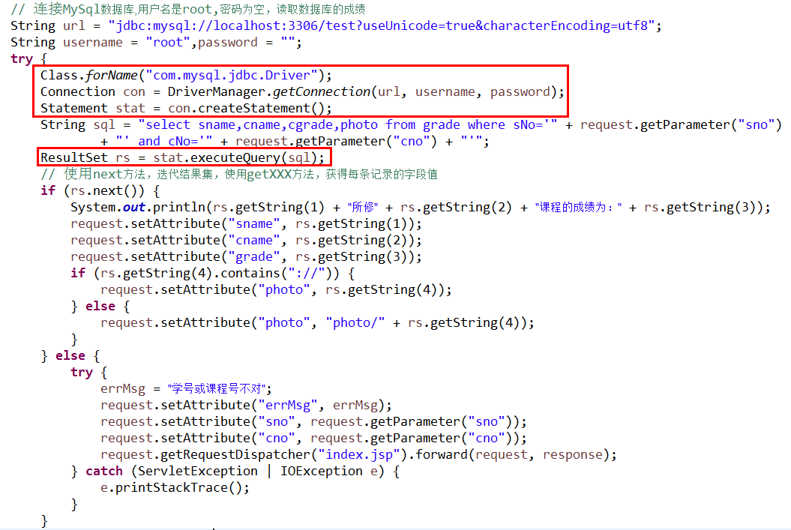
使用JDBC访问数据库
Java原生态编程方法：
访问数据库所需要的对象在程序中创建
Notes:
import java.io.IOException;
import java.sql.Connection;
import java.sql.DriverManager;
import java.sql.ResultSet;
import java.sql.SQLException;
import java.sql.Statement;
import javax.servlet.ServletException;
import javax.servlet.annotation.WebServlet;
import javax.servlet.http.HttpServlet;
import javax.servlet.http.HttpServletRequest;
import javax.servlet.http.HttpServletResponse;
/**
* Servlet implementation class QueryServlet
*/
@WebServlet({ "/QueryServlet", "/query" })
public class QueryServlet extends HttpServlet {
private static final long serialVersionUID = 1L;
/**
* @see HttpServlet#HttpServlet()
*/
public QueryServlet() {
super();
// TODO Auto-generated constructor stub
}
/**
* @see HttpServlet#doGet(HttpServletRequest request, HttpServletResponse
* response)
*/
protected void doGet(HttpServletRequest request, HttpServletResponse response)
throws ServletException, IOException {
// doGet1(request, response);
doGet2(request, response);
}
private void doGet2(HttpServletRequest request, HttpServletResponse response) {
String errMsg = "";
// TODO Auto-generated method stub
// 连接MySql数据库,用户名是root,密码为空，读取数据库的成绩
String url = "jdbc:mysql://localhost:3306/test?useUnicode=true&characterEncoding=utf8";
String username = "root",password = "";
try {
Class.forName("com.mysql.jdbc.Driver");
Connection con = DriverManager.getConnection(url, username, password);
Statement stat = con.createStatement();
String sql = "select sname,cname,cgrade,photo from grade where sNo='" + request.getParameter("sno")
+ "' and cNo='" + request.getParameter("cno") + "'";
ResultSet rs = stat.executeQuery(sql);
// 使用next方法，迭代结果集，使用getXXX方法，获得每条记录的字段值
if (rs.next()) {
System.out.println(rs.getString(1) + "所修" + rs.getString(2) + "课程的成绩为：" + rs.getString(3));
request.setAttribute("sname", rs.getString(1));
request.setAttribute("cname", rs.getString(2));
request.setAttribute("grade", rs.getString(3));
if (rs.getString(4).contains("://")) {
request.setAttribute("photo", rs.getString(4));
} else {
request.setAttribute("photo", "photo/" + rs.getString(4));
}
} else {
try {
errMsg = "学号或课程号不对";
request.setAttribute("errMsg", errMsg);
request.setAttribute("sno", request.getParameter("sno"));
request.setAttribute("cno", request.getParameter("cno"));
request.getRequestDispatcher("index.jsp").forward(request, response);
} catch (ServletException | IOException e) {
e.printStackTrace();
}
}
} catch (SQLException se) {
System.out.println("数据库连接失败！");
se.printStackTrace();
} catch (ClassNotFoundException e) {
e.printStackTrace();
}
try {
request.getRequestDispatcher("result.jsp").forward(request, response);
} catch (ServletException | IOException e) {
// TODO Auto-generated catch block
e.printStackTrace();
}
}
private void doGet1(HttpServletRequest request, HttpServletResponse response) throws IOException {
// TODO Auto-generated method stub
System.out.println("doGet");
response.setContentType("text/html;charset=gb2312");
response.getWriter().append("Served at: ").append(request.getContextPath());
response.getWriter().append("<p>" + request.getRequestURL());
response.getWriter().append("<p>sno=" + request.getParameter("sno"));
response.getWriter().append("<p>cno=" + request.getParameter("cno"));
response.getWriter().append("<p><img src='photo/" + request.getParameter("sno") + ".jpg'/>");
// 读取数据库的成绩
// 连接MySql数据库，用户名和密码都是root
String url = "jdbc:mysql://localhost:3306/test?useUnicode=true&characterEncoding=utf8";
String username = "root";
String password = "";
try {
Class.forName("com.mysql.jdbc.Driver");
Connection con = DriverManager.getConnection(url, username, password);
Statement stat = con.createStatement();
// sname,cname,cgrade,cno,sno
String sql = "select sname,cname,cgrade from grade where sNo='" + request.getParameter("sno")
+ "' and cNo='" + request.getParameter("cno") + "'";
System.out.println(sql);
ResultSet rs = stat.executeQuery(sql);
// 使用next方法，迭代结果集，使用getXXX方法，获得每条记录的字段值
while (rs.next()) {
System.out.println(rs.getString(1) + "所修" + rs.getString(2) + "课程的成绩为：" + rs.getString(3));
response.getWriter()
.append("<p>" + rs.getString(1) + "所修" + rs.getString(2) + "课程的成绩为：" + rs.getString(3));
}
} catch (SQLException se) {
System.out.println("数据库连接失败！");
se.printStackTrace();
} catch (ClassNotFoundException e) {
e.printStackTrace();
}
// response.sendRedirect("http://www.hao123.com");
}
/**
* @see HttpServlet#doPost(HttpServletRequest request, HttpServletResponse
* response)
*/
protected void doPost(HttpServletRequest request, HttpServletResponse response)
throws ServletException, IOException {
// TODO Auto-generated method stub
System.out.println("doPost");
doGet(request, response);
}
}

Slide 2
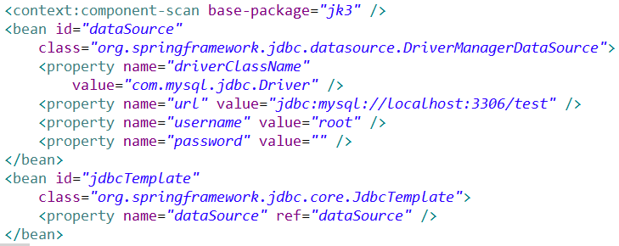
使用JDBC访问数据库
Spring框架编程方法(依赖注入第三方框架)：
在Spring框架配置文件springmvc.xml中利用第三方框架提供的实现配置bean组件：

Slide 3
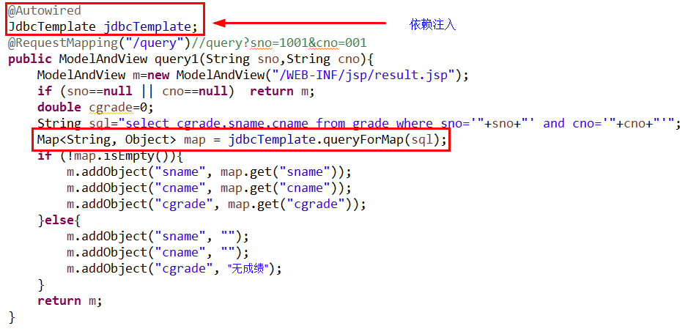
使用JDBC访问数据库
Spring框架编程方法(依赖注入第三方框架)：
访问数据库所需要的对象由Spring容器根据配置情况创建后注入。

Slide 4
使用JDBC访问数据库
两种实现方法对比
Java原生态编程方法
Spring框架依赖注入方法

